Slide 1
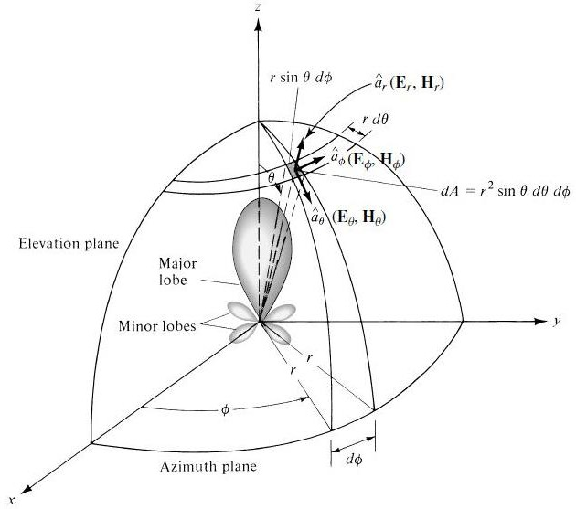
Antenna and Wave Propagation Antenna parameters
Antenna parameters
The antenna parameters are used to describe the antenna performance, this lecture introduce a specific definition of some type of these parameters.
Radiation Pattern
An antenna radiation pattern or antenna pattern is defined as a graphical representation of the radiation properties of the antenna as a function of space coordinates. In most cases, the radiation pattern is determined in the far-field region and is represented as a function of the directional coordinates. Radiation properties include power flux density, radiation intensity, field strength, directivity, phase or polarization.” The radiation property of most concern is the two- or three dimensional spatial distribution of radiated energy as a function of the observer’s position along a path or surface of constant radius.
Figure (1): Coordinate System for Antenna Analysis.

Slide 2
Antenna and Wave Propagation Antenna parameters
A convenient set of coordinates is shown in Figure (1). A trace of the received electric (magnetic) field at a constant radius is called the amplitude field pattern.
On the other hand, a graph of the spatial variation of the power density along a constant radius is called an amplitude power pattern.
Often the field and power patterns are normalized with respect to their maximum value, yielding normalized field and power patterns.
Also, the power patterns usually plotted on a logarithmic scale or more commonly
in decibels (dB). This scale is usually desirable because a logarithmic scale can accentuate in more details those parts of the pattern that have very low values, which later we will refer to as minor lobes. For an antenna, the
Field pattern :( in linear scale) typically represents a plot of the magnitude of the electric or magnetic field as a function of the angular space.
Power pattern :( in linear scale) typically represents a plot of the square of the magnitude of the electric or magnetic field as a function of the angular space.
Power pattern :( in dB) represents the magnitude of the electric or magnetic field, in decibels, as a function of the angular space.
To demonstrate this, the two-dimensional normalized field pattern (plotted in linear scale), power pattern (plotted in linear scale), and power pattern (plotted on a logarithmic dB scale) of a specific antenna of isotropic sources, are shown in Figure (2).
To find the points where the pattern achieves its half-power points, relative to the maximum value of the pattern, you set the value of the
Field pattern at 0.707 value of its maximum, as shown in Figure (2- a)
Power pattern (in a linear scale) at its 0.5 value of its maximum, as shown in Figure (2- b).
Power pattern (in dB) at −3 dB value of its maximum, as shown in Figure (2- c).

Slide 3

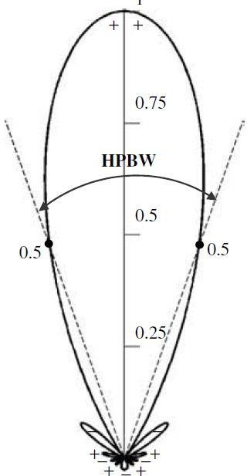
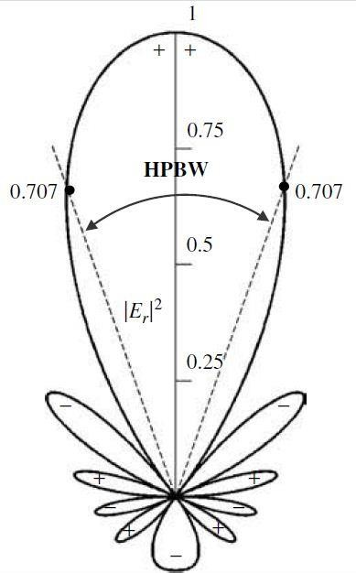
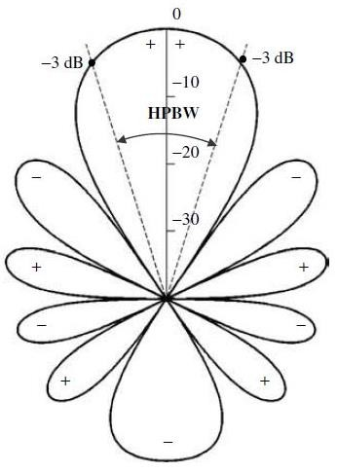




Antenna and Wave Propagation Antenna parameters
(a)
(b)
(c) Figure (2)
In practice, the three-dimensional pattern is measured and recorded in a series of
two-dimensional patterns. However, for most practical applications, a few plots of the
pattern as a function of θ for some particular values of φ, plus a few plots as a function of φ for some particular values of θ, give most of the useful and needed information.

Slide 4
Antenna and Wave Propagation Antenna parameters
Beamwidth
Associated with the pattern of an antenna is a parameter designated as Beamwidth. The beamwidth of a pattern is defined as the angular separation between
two identical points on opposite side of the pattern maximum. In an antenna pattern, there are a number of beam widths. One of the most widely used beam widths is the Half-Power Beamwidth (HPBW), which is defined by IEEE as: “In a plane containing the direction of the maximum of a beam, the angle between the two directions in which
the radiation intensity is one-half value of the beam.”
Another important beamwidth is the angular separation between the first nulls of the pattern, and it is referred to as the First-Null Beamwidth (FNBW). Both the HPBW and FNBW are demonstrated for the pattern in Figure (2.3). Other beamwidths are those where the patterns −10 dB from the maximum, or any other value. However, in practice,
the term beamwidth, with no other identification, usually refers to HPBW.
The beamwidth of an antenna is a very important figure of merit and often is used as a trade-off between it and the side lobe level; that is, as the beamwidth decreases, the side lobe increases and vice versa. In addition, the beamwidth of the antenna is also used
to describe the resolution capabilities of the antenna to distinguish between two adjacent radiating sources or radar targets.
The half-power beamwidth is the angular separation of the points where the main beam of the power pattern equals one-half. Hence
^{H P = |𝜃}𝐻𝑃 𝑙𝑒𝑓𝑡 ^{− 𝜃}𝐻𝑃 𝑅𝑖𝑔ℎ𝑡|
W h e r e 𝜃_{𝐻𝑃 𝑙𝑒𝑓𝑡} 𝑎𝑛𝑑 are the point to the left and right of the main
^{𝜃}𝐻𝑃 𝑅𝑖𝑔ℎ𝑡
beam of the main beam maximum for which the power pattern has a value of one half.
1
For example, the 𝑆𝑖𝑛 𝜃 pattern of an ideal dipole has a value of for 𝜃 values of
⁄
√2
𝜃_{𝐻𝑃 𝑙𝑒𝑓𝑡} = 135° and
𝜃_{𝐻𝑃 𝑅𝑖𝑔ℎ𝑡} = 45°. Then HP = | 135° - 45°| = 90°.

Slide 5
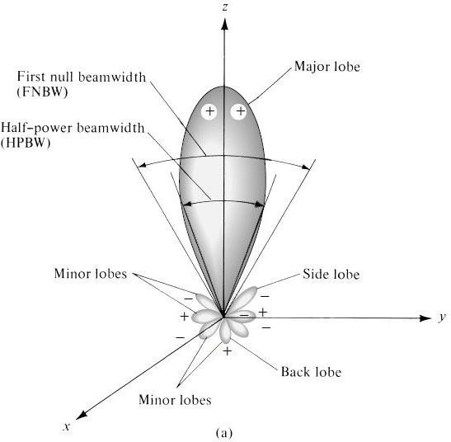
Antenna and Wave Propagation Antenna parameters
Side Lobe
In radiation pattern of antennas, in addition to principal or major or main lobes there are also secondary and minor lobes. The minor lobes are just adjacent to the main lobe
and are called "side lobes".
These side lobes are undesirable because not only considerable amount of power is wasted in the directions of side lobes but even unnecessary interference is also caused in those areas. For the directional antennas, we should reduce the side lobes.
The technique used in reduction of side lobes is called tapering.
Various parts of a radiation pattern are referred to as lobes, which may be sub classified into major or main, minor, side, and back lobes. A radiation lobe is a “portion of the radiation pattern bounded by regions of relatively weak radiation intensity.” Figure 2.3(a) demonstrates a symmetrical three-dimensional polar pattern with a number of radiation lobes. Some are of greater radiation intensity than others, but all are classified as lobes. Figure 2.3(b) illustrates a linear two-dimensional pattern [one plane of Figure 2.3(a)] where the same pattern characteristics are indicated.
Figure 2.3(a)

Slide 6
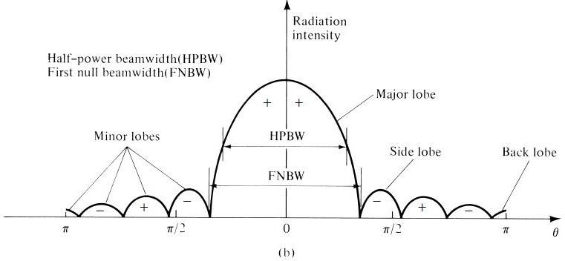
Antenna and Wave Propagation Antenna parameters
Figure 2.3(b)
Side Lobe Level (SLL)
A measure of how well the power is concentrated into the main lobe is the (relative) side lobe level, which is the ratio of the pattern value of a side lobe peak to the pattern value of the main lobe.
Field Regions
The space surrounding an antenna is usually subdivided into three regions:
Reactive near-field.
Radiating near-field (Fresnel) and
Far-field regions (Fraunhofer) as shown in Figure (2.4). These regions are so designated to identify the field structure in each. Although no abrupt changes in the field
configurations are noted as the boundaries are crossed, there are distinct differences among them. The boundaries separating these regions are not unique, although various criteria have been established and are commonly used to identify the regions.

Slide 7




Antenna and Wave Propagation Antenna parameters
Radiative
near-field region
Reactive Near-field region
R
1
R1 = 0.62 √D³/λ
R2 = 2D²/λ
R 2
Radiative Far-field region
Figure (2.4): Field Regions
Reactive Near-Field Region
It is defined as “that portion of the near-field region immediately surrounding the antenna wherein the reactive field predominates.” For most antennas, the outer boundary
of this region is commonly taken to exist at a distance R < 0.62 √D³/λ from the antenna surface, where λ is the wavelength and D is the largest dimension of the antenna. “For a very short dipole, or equivalent radiator, the outer boundary is commonly taken to exist at a distance λ/2π from the antenna surface.”
Radiative near-field region
Is defined as “that region of the field of an antenna between the reactive near-field region and the far-field region wherein radiation fields predominate and wherein the angular field distribution is dependent upon the distance from the antenna. If the antenna has a maximum dimension that is not large compared to the wavelength, this region may not exist. For an antenna focused at infinity, the radiating near-field region is sometimes referred to as the Fresnel region on the basis of analogy to optical terminology. If the antenna has a maximum overall dimension which is very small compared to the wavelength, this field region may not exist.” The inner boundary is taken to be the

Slide 8
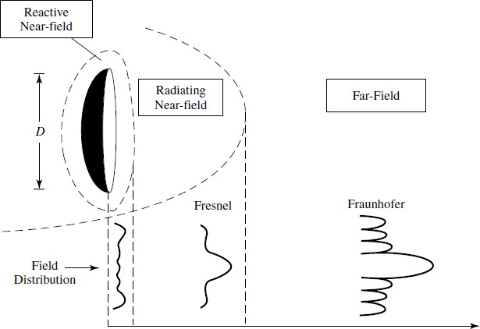
Antenna and Wave Propagation Antenna parameters
distance R ≥ 0.62 √D³/λ and the outer boundary the distance R < 2D²/λ where D is the largest dimension of the antenna.
Far-field (Fraunhofer) region
Is defined as “that region of the field of an antenna where the angular field distribution is essentially independent of the distance from the antenna. If the antenna has a maximum∗ overall dimension D, the far-field region is commonly taken to exist
at distances greater than 2D²/λ from the antenna.

